Slide 1
ELi Digital Hub
ELi Publishing Digital Environment

Slide 2
Agenda
How to log in
Student account and teacher account
How to activate a digital book
The digital book and interactive resources
ELi Classroom
ELi Test Room
ELi LINK
How to assign a book to a teacher
ELi CLOUD - A shared folder with promotional material

Slide 3
How to log in

Slide 4
How to log in
A dedicated website (Available in English, Spanish and Italian)
https://elidigitalhub.elionline.com/
From elionline.com
www.elionline.com/digitalbook
Notes:
la piattaforma viene visualizzata in base alla lingua del browser

Slide 5
Registration
Three types of accounts available:
Student
Teacher
Parent
Teachers who already have an account on elionline.com can use the ELIONLINE.COM ACCOUNT LOGIN and complete the profile.
Notes:
ACCEDI CON ELIONLINE non significa che devi fare login con le credenziali del sito ELI. Devi cliccare su ACCEDI CON ELI e poi inserire le credenziali di eli nelle schermate che ti vengono proposte. In ogni caso, se si registrano di nuovo è uguale per noi.

Slide 6
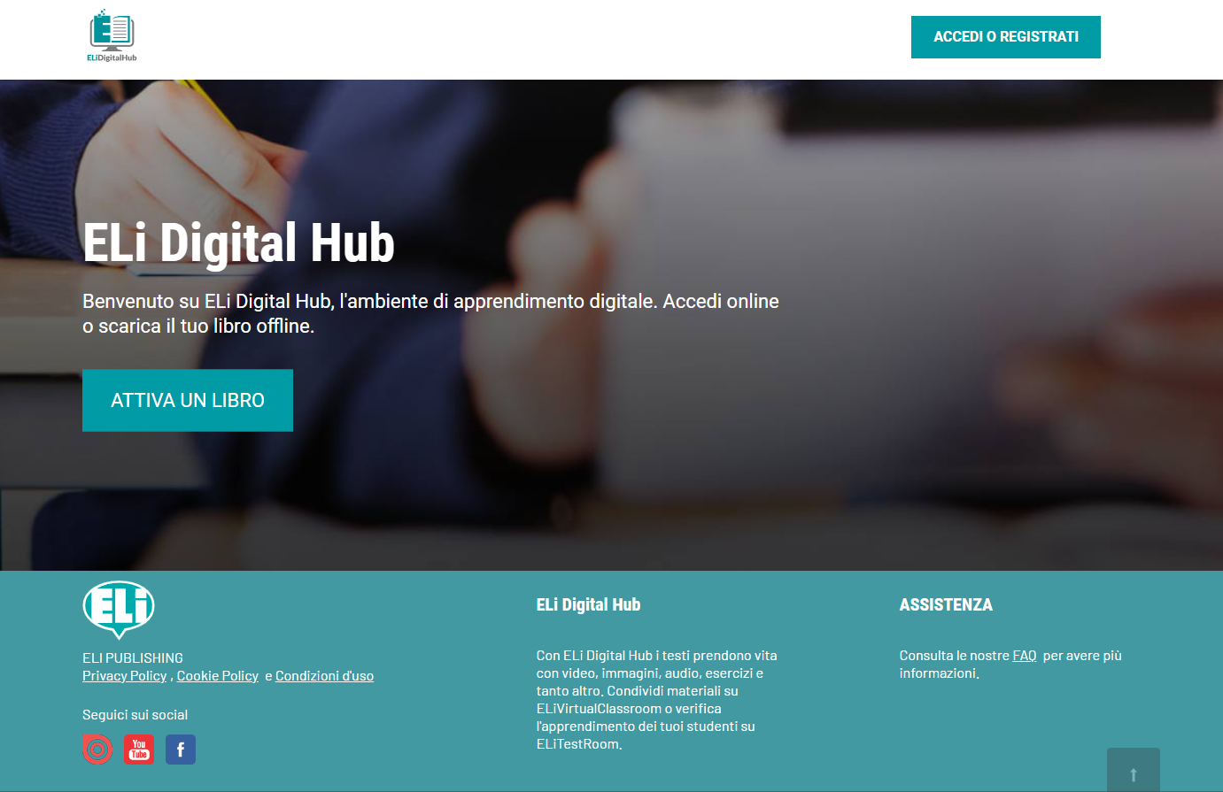
Notes:
versione italiano

Slide 7
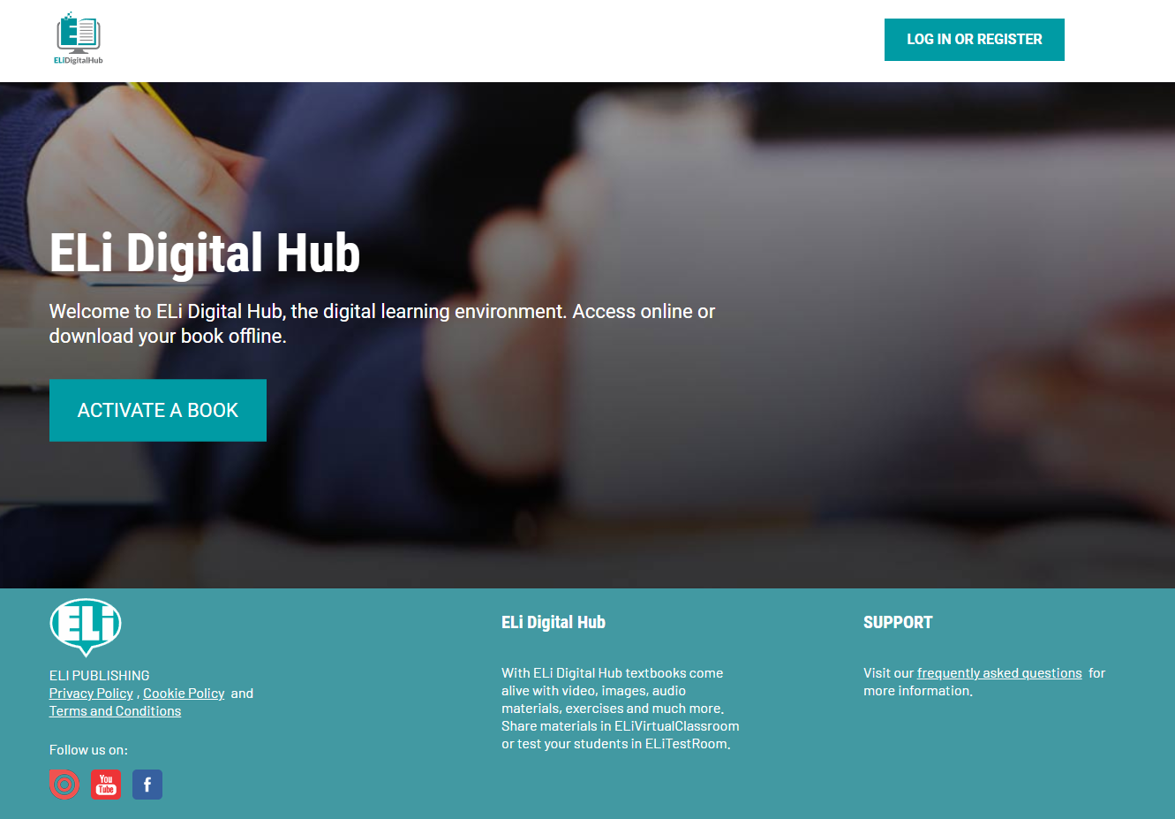
Notes:
versione inglese

Slide 8
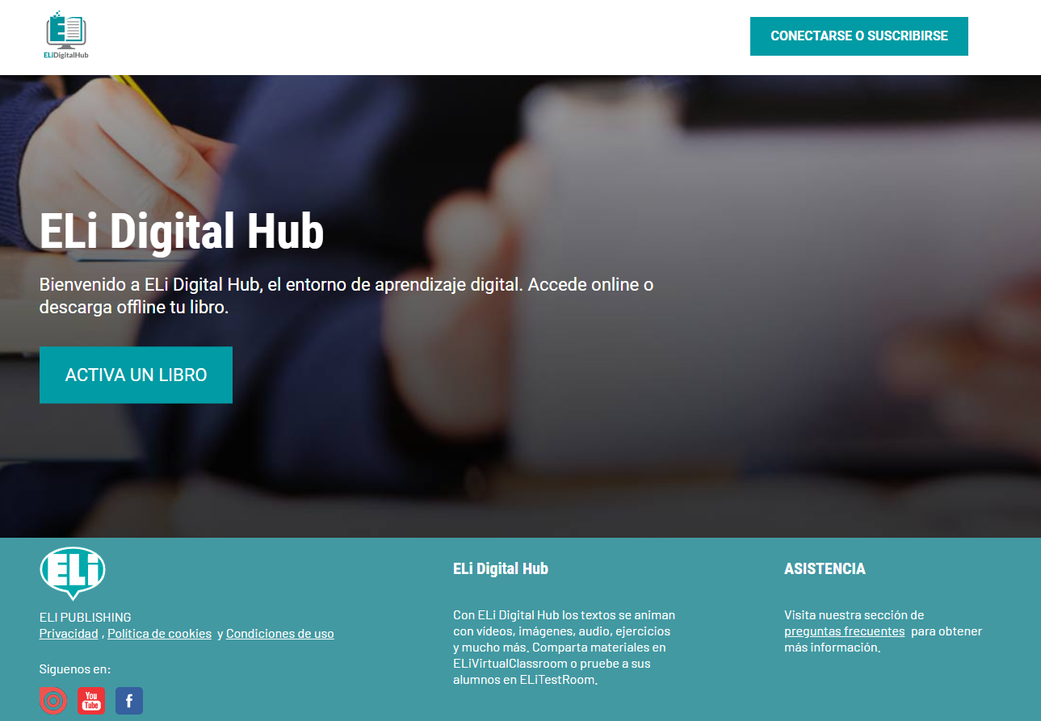
Notes:
versione spagnolo

Slide 9
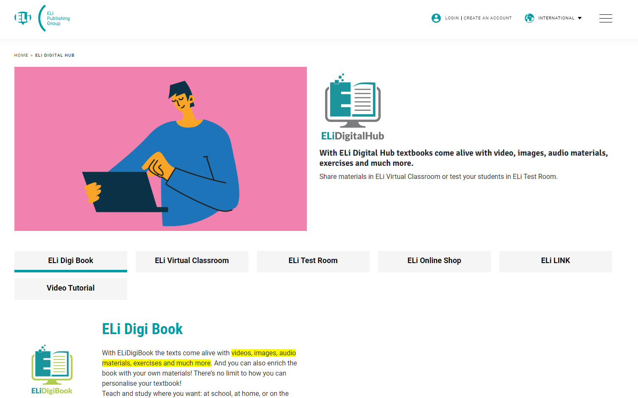
Notes:
come ci si arriva dal sito elionline.com

Slide 10
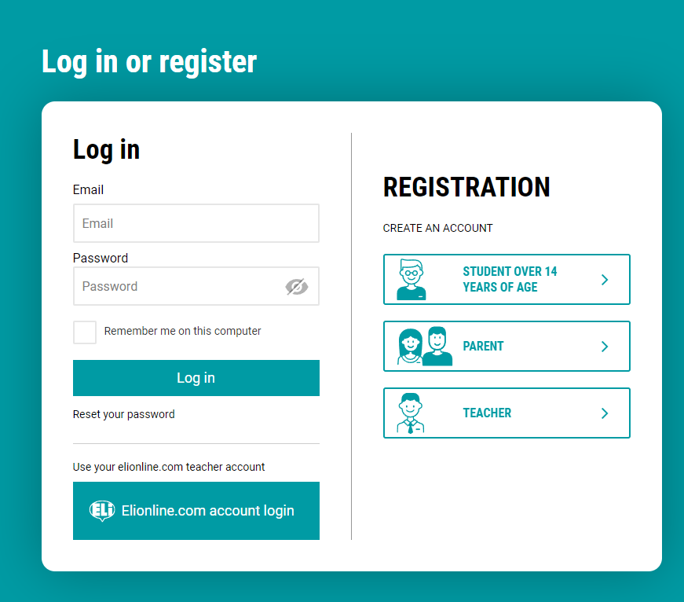

Slide 11
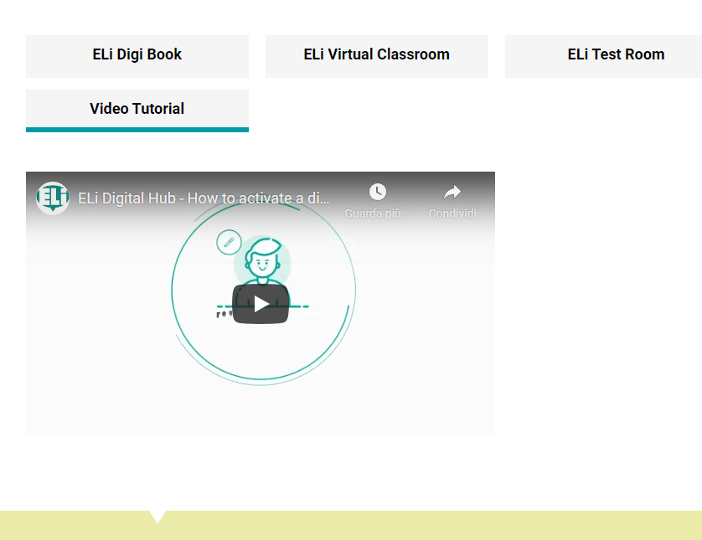
Registration
Video tutorial available on elionline.com/digitalbook

Slide 12
Student account and teacher account

Slide 13
Student account and teacher account
Student account
register as a student
use student code (printed in the SB/WB)
no ANSWER KEYS included with the exercises
can be invited by the teacher to participate in virtual classes
receives Test and Assignment notifications

Slide 14
Student account and teacher account
Teacher account
register as a teacher
use teacher code starting with ELICERT- (printed in the guide)
has the ANSWER KEYS with the exercises
access to teaching resources in the digital book (pdf guide)
manage and create virtual classrooms, invite students, assign exercises and tests, access reports/scores/grades
Notes:
Uno studente che per fare il furbo si registra come docente e inserisce il codice studente, non viene riconosciuto dalla piattaforma come docente certificato. quindi non accede alla risorse docente

Slide 15
How to activate a digital book

Slide 16
How to activate a digital book
Once the account has been created and logged into ELI Digital Hub, users can proceed with activation of the digital book
Student: code printed in the SB/WB
Teacher: code printed in the guide
Notes:
ogni studente ha un codice diverso, può essere usato solo una volta

Slide 17
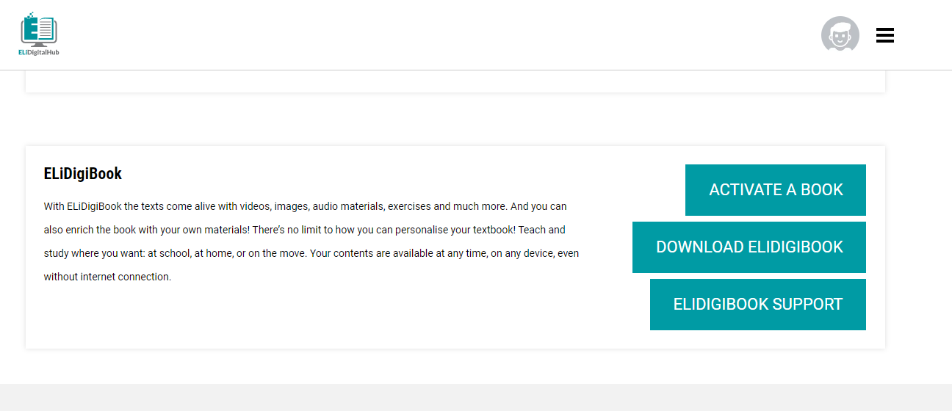
Notes:
elidigibook può essere anche scaricato offline su windows, mac, ipad e table android

Slide 18
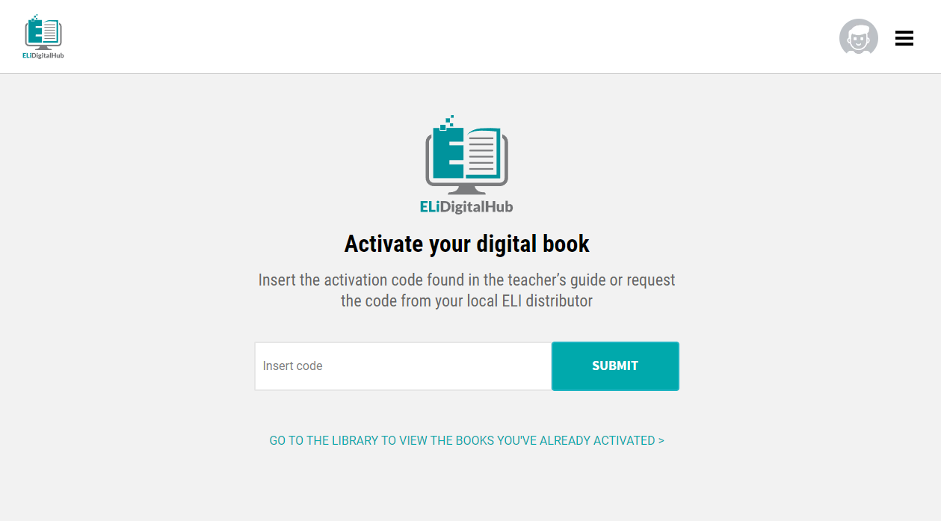

Slide 19
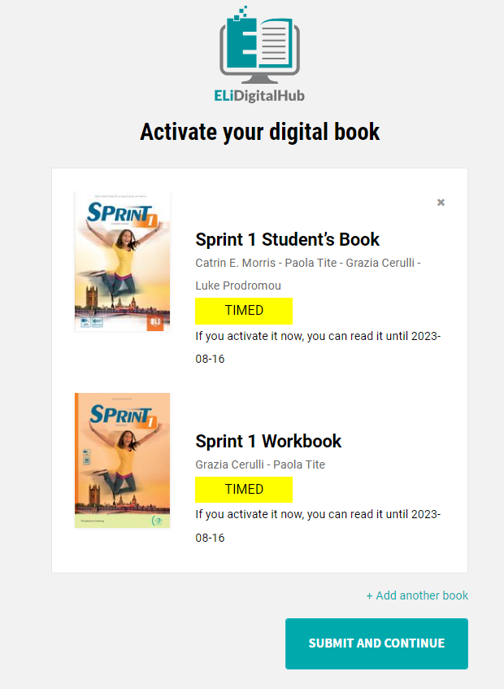
Digital books have an expiration date
Courses 14 months
Graded Readers 18 months
The supplementary material (dictionaries, teaching resources ...) do not expire
Once the activation period has expired, it will no longer be possible to access the digital book.

Slide 20
The digital book

Slide 21
The digital book
Users can find all the activated digital books in the library

Slide 22
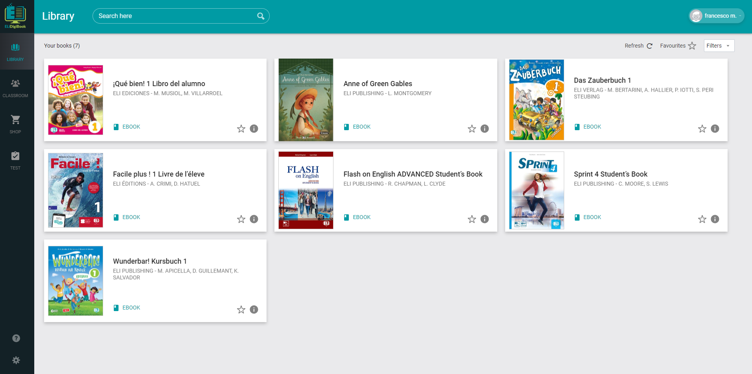

Slide 23
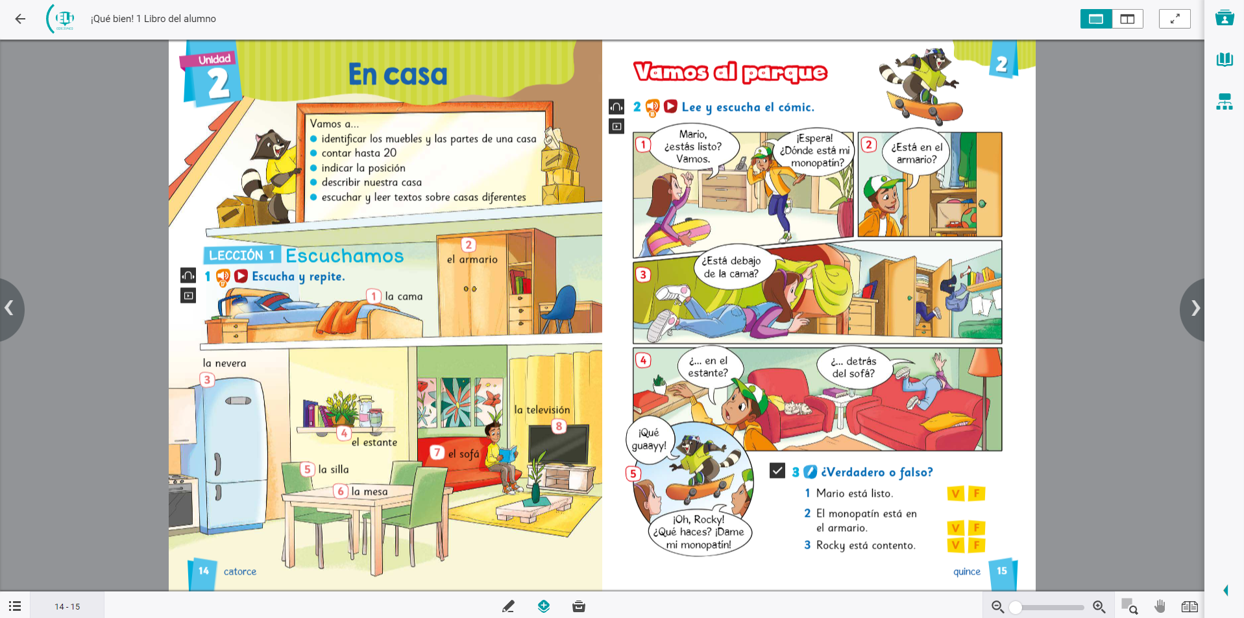

Slide 24
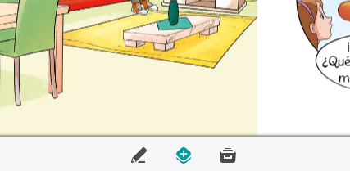
The digital book - The tools
Personalize the book with notes, images, highlights, notes
Resources panel. All resources organized by type: audio, video, exercises, pdf, links ...

Slide 25
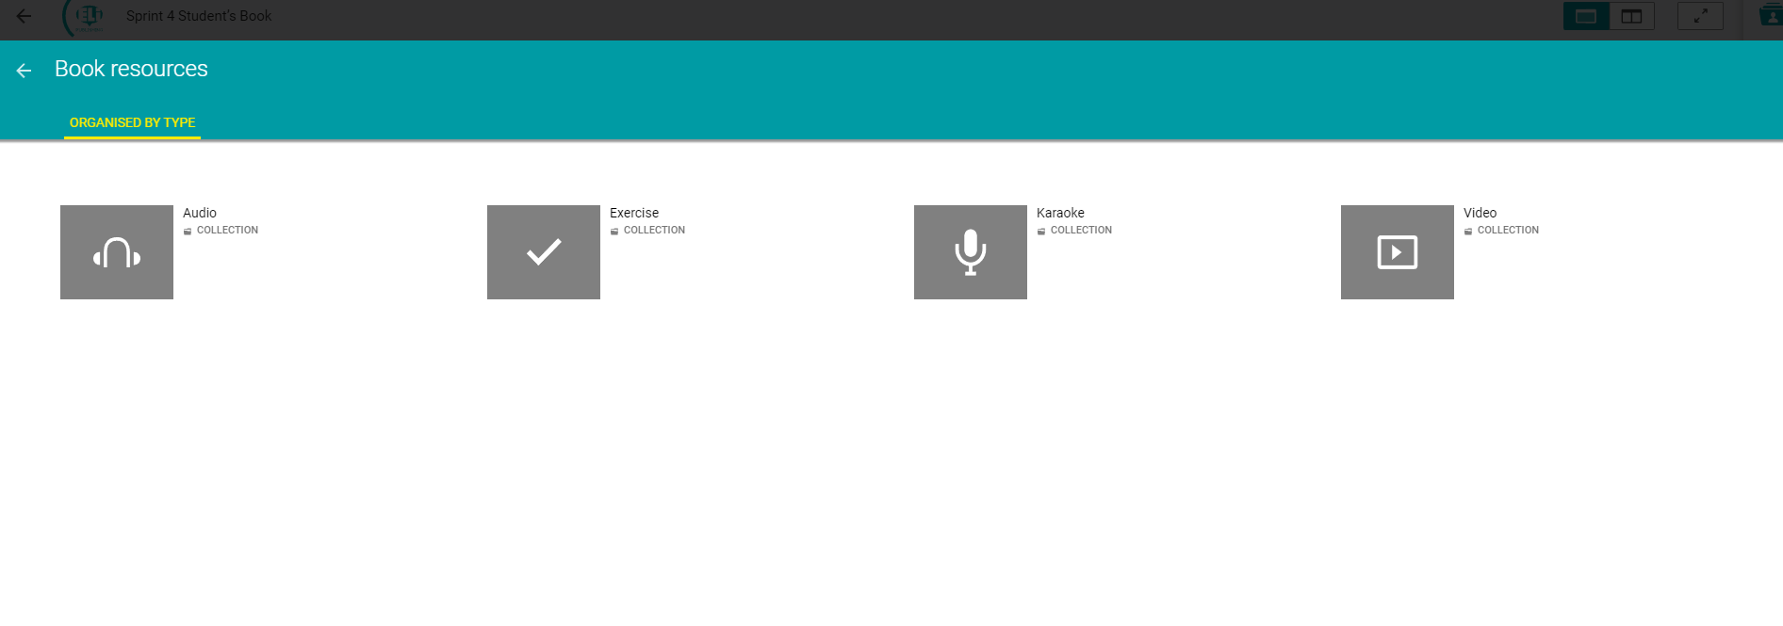
Notes:
Pannello risorse

Slide 26
The digital book - The tools
Teachers can add personal files in the digital book: audio, video, ppt, images ...

Slide 27
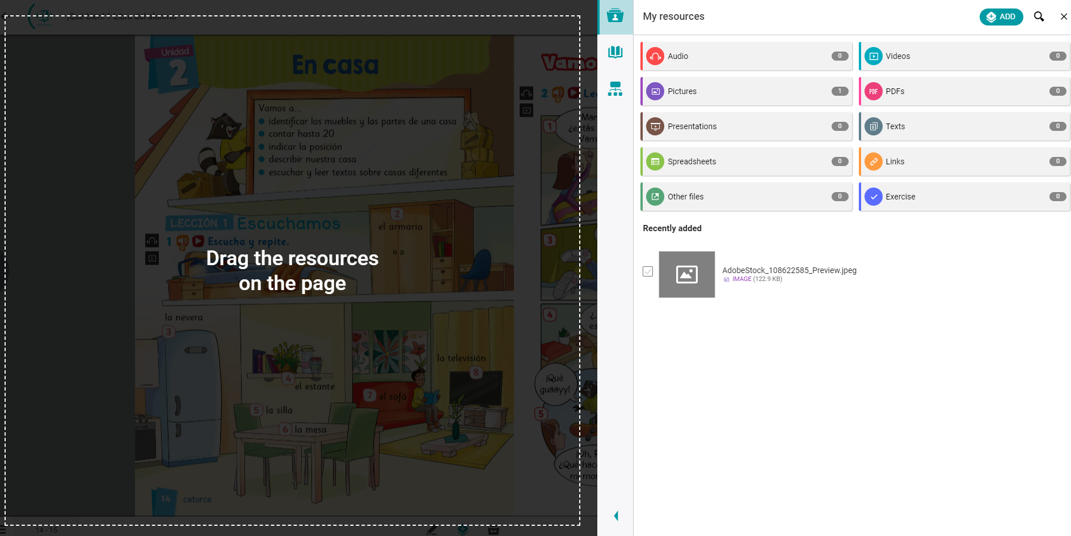

Slide 28
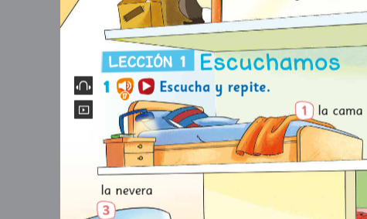
The digital book - The interactive contents
The black icons on the page indicate the presence of digital content: audio, video, links, interactive exercises

Slide 29
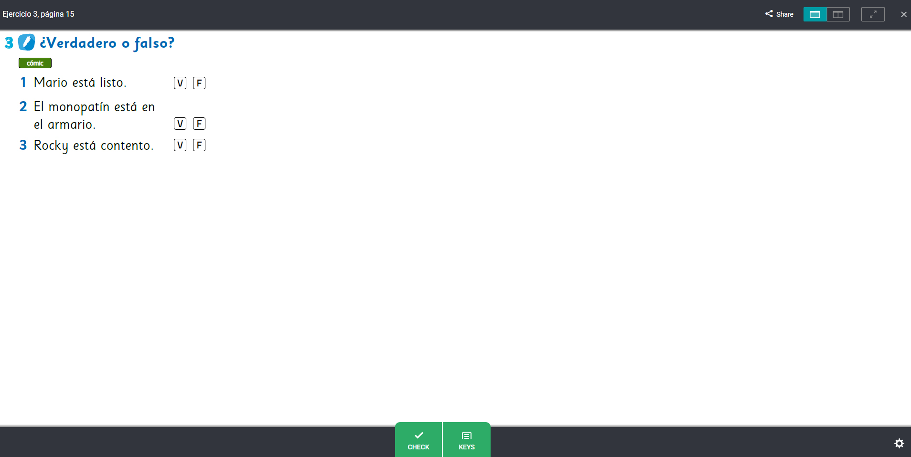

Slide 31
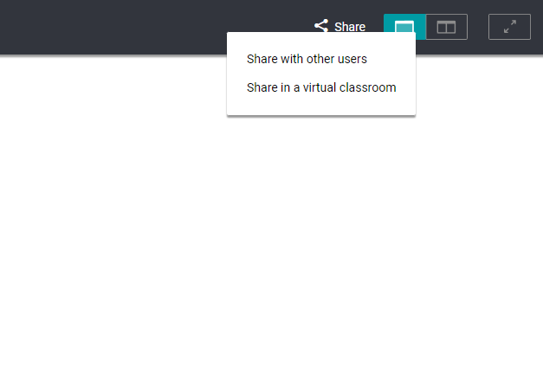
The digital book - Sharing digital content
All digital content can be shared with students in ELi Classroom
To access the content, the student must have activated the digital book.

Slide 32
ELi Classroom

Slide 33
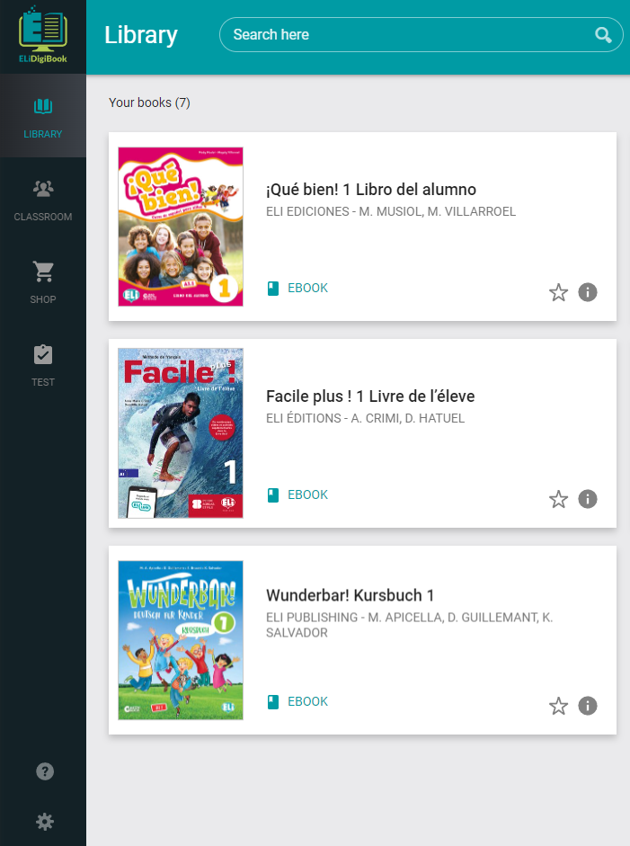
ELi Classroom
Access from the dashboard or library.
An environment for sharing content and messaging between teachers and students organized in groups.

Slide 34
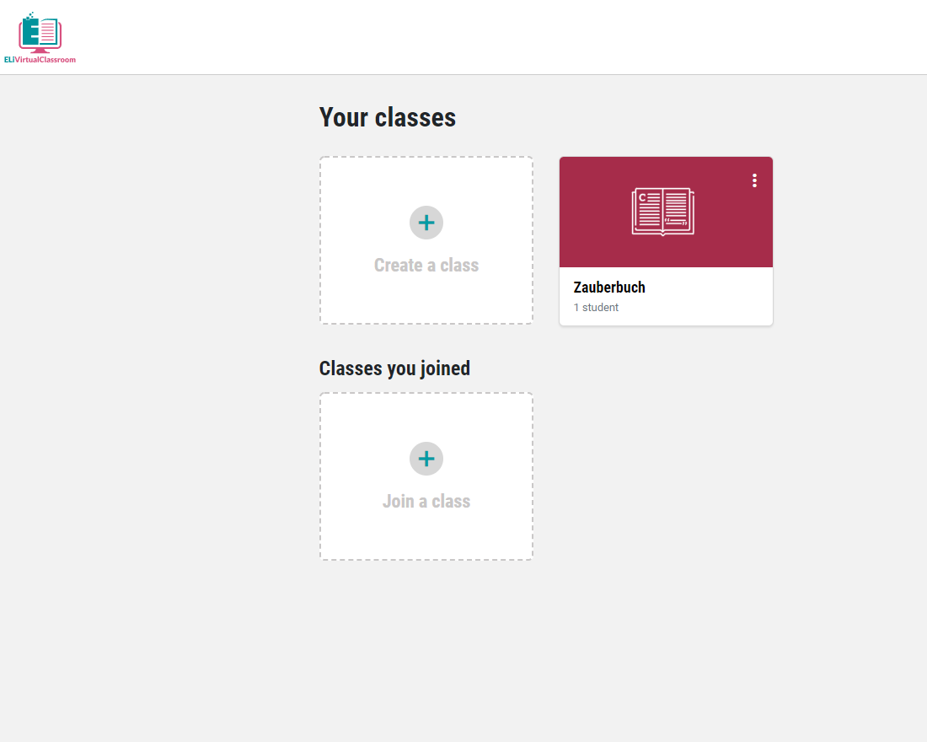
ELi Classroom
Teachers can log in with the same email and pwd as ELi HUB.
Teachers can create a new class / group and invite students to join the class by giving them the access code.

Slide 35
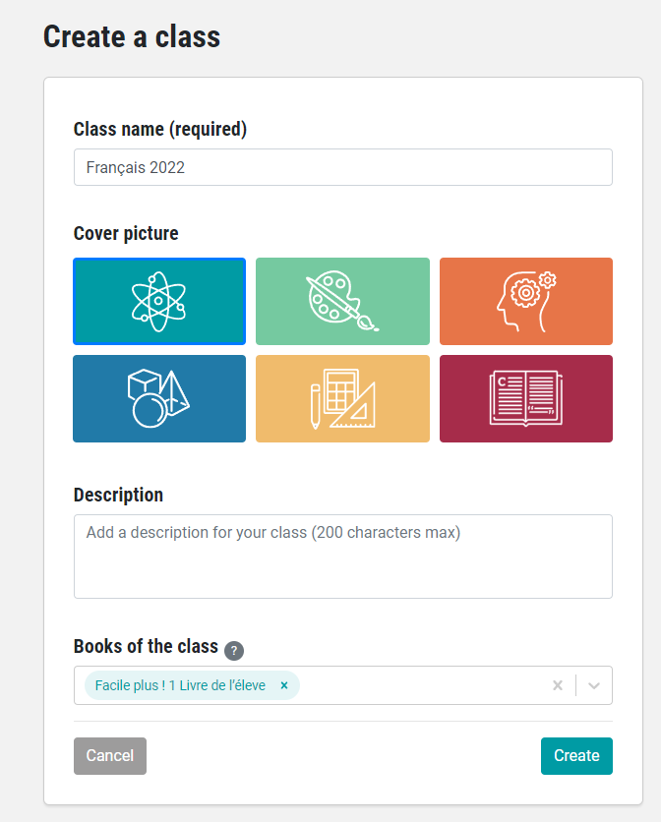
Notes:
Ogni classe/gruppo va associata ad un libro attivato

Slide 36
ELi Classroom
Students must have an account on Eli HUB to join a Class and enter the class code generated by the platform.
Each class has a different code.
Teachers can create as many classes as they would like.
Notes:
il codice classe per accedere a Classroom è diverso da quello di attivazione del libro digitale

Slide 37
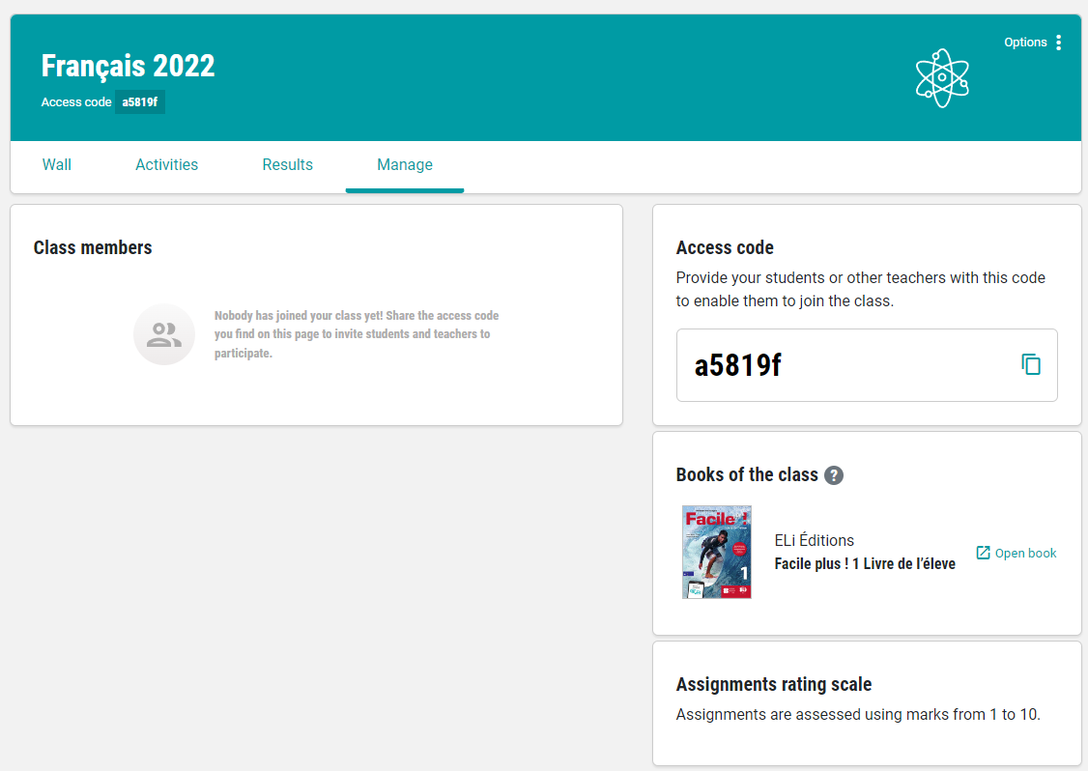

Slide 38
ELi Classroom
Teachers
can send messages to the class / individual students
can send files to the class / individual students
can assign tasks to the class / individual students and access a report of the activities carried out

Slide 39
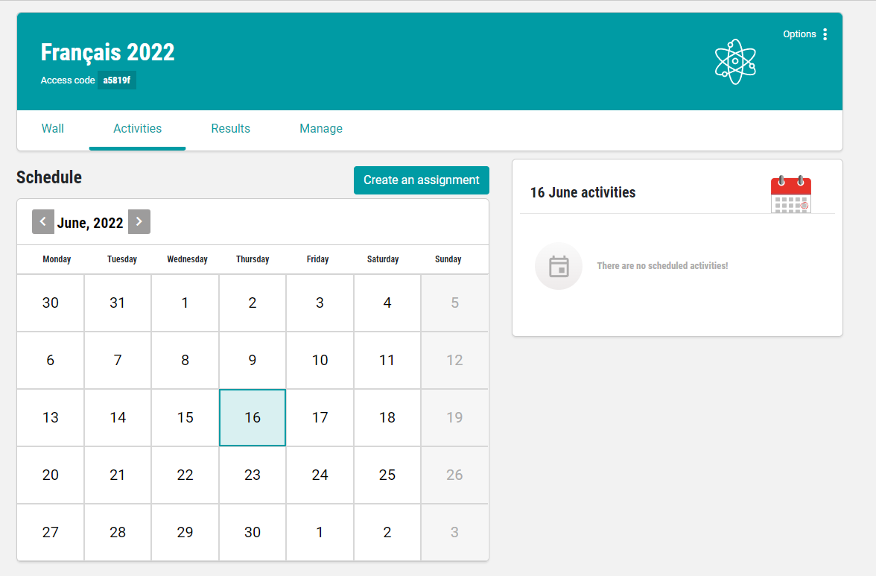

Slide 40
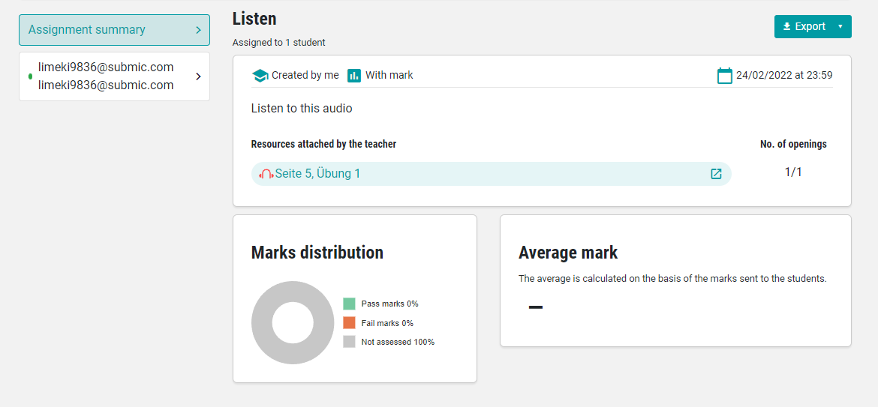

Slide 41
ELi Test Room

Slide 42
ELi Test Room
Access from the dashboard or library.
An assessment environment with lots of interactive grammar tests in English, French, German, Spanish, Italian L2.
Available for selected products.

Slide 43
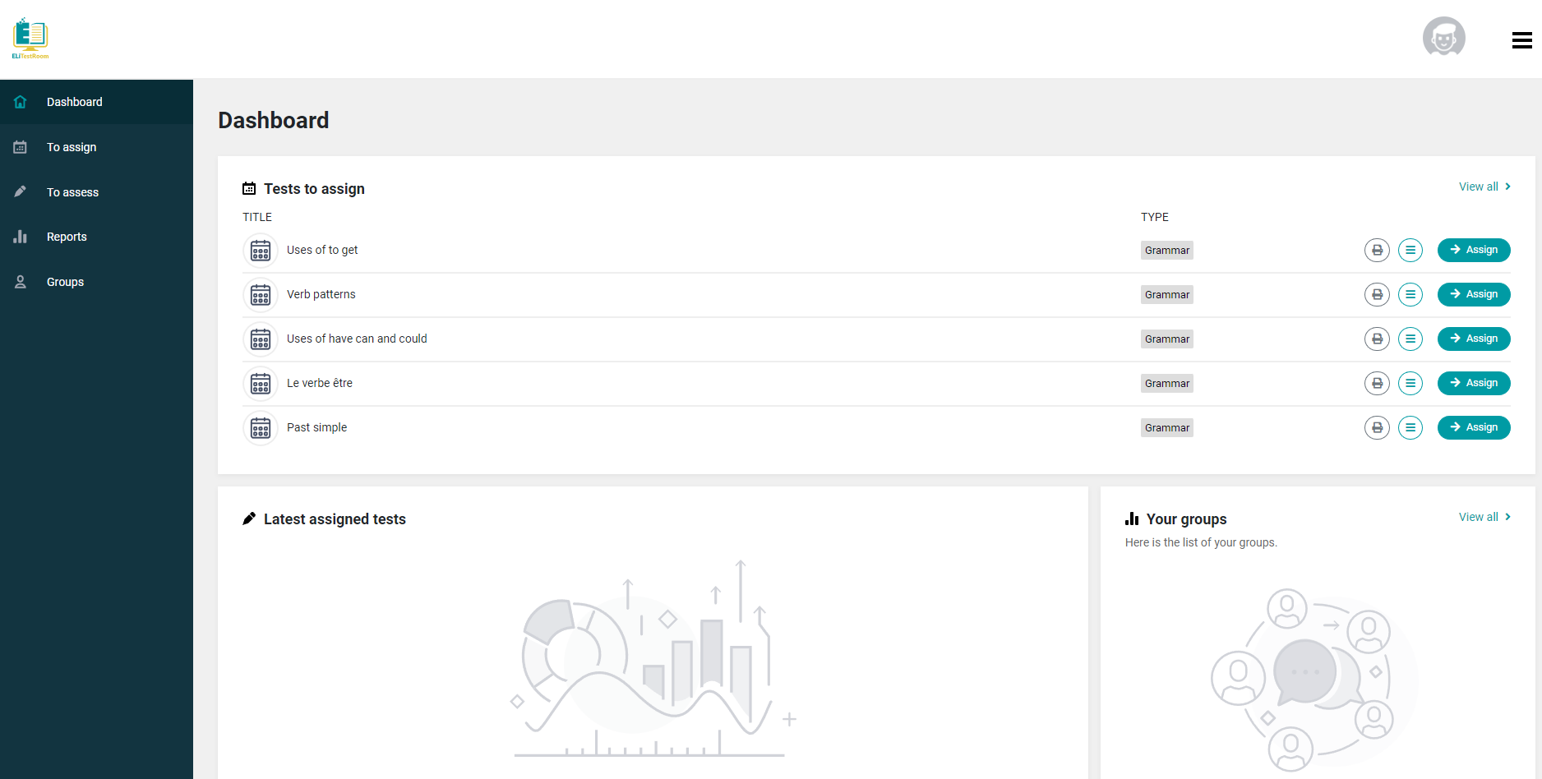

Slide 44
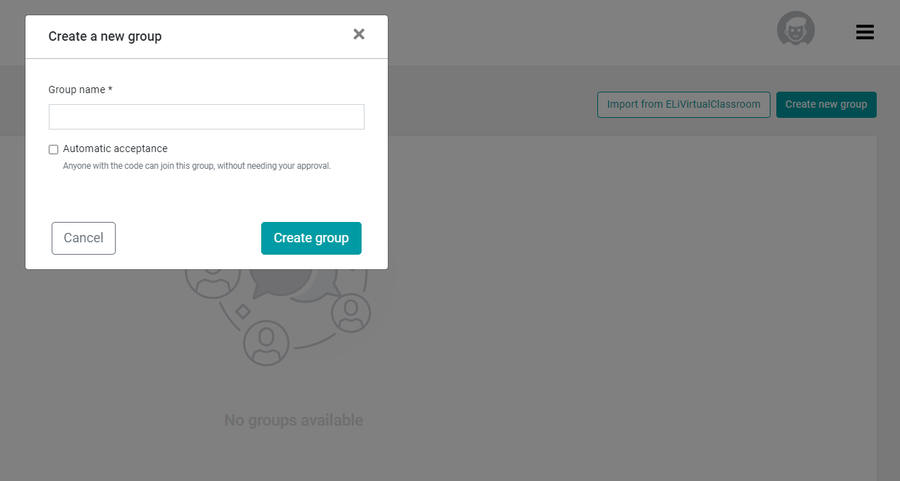
ELi Test Room
Teachers can log in with the same email address and pwd as ELi HUB.
Teachers can create a new class / group and invite students to join the class.

Slide 45
ELi Test Room
Students must have an account on Eli HUB to join a Class and enter the class code generated by the platform.
Each class has a different code.
Teachers can create as many classes as they would like.

Slide 47
ELi Test Room
Teachers can select tests based on the subject, level, age of their students. Teachers can also select tests based on the ELi product.
Teachers can only access Tests if they activate a Digital Book. They can only assign the Tests associated with that Textbook.
Students do not have access to the tests until they are invited by the teacher to a class.

Slide 48
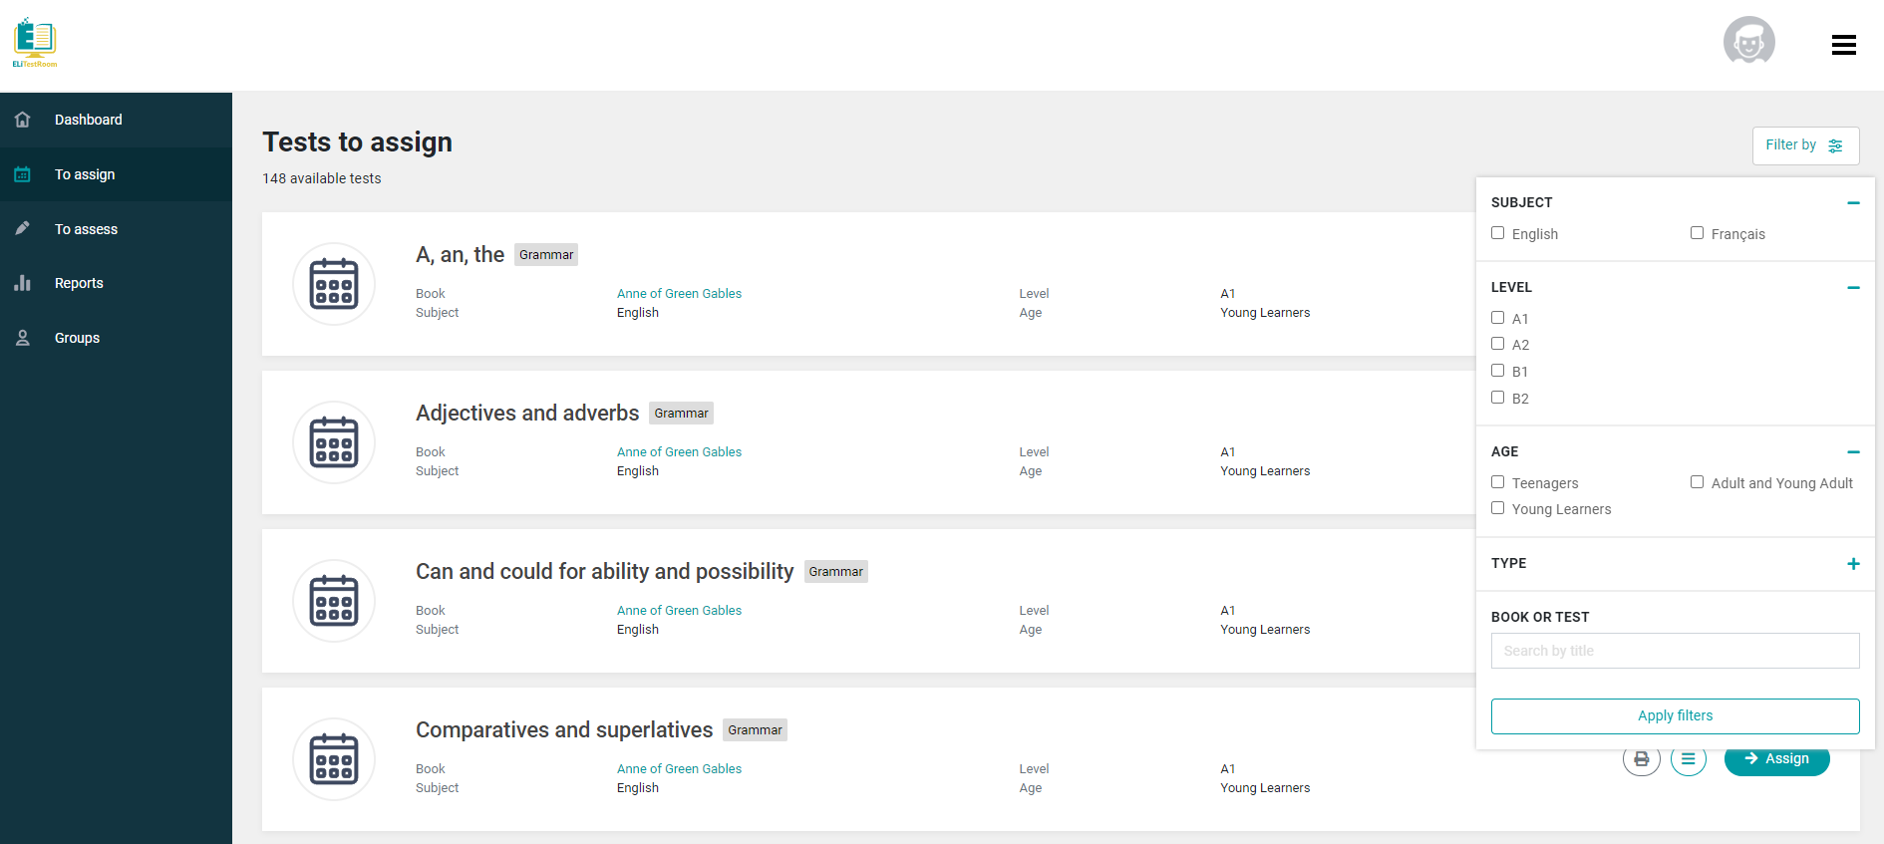

Slide 49
ELi Test Room
Teachers can preview tests before assigning them to the class.
Teachers can also export the tests as a pdf in Row A and Row B format.

Slide 50
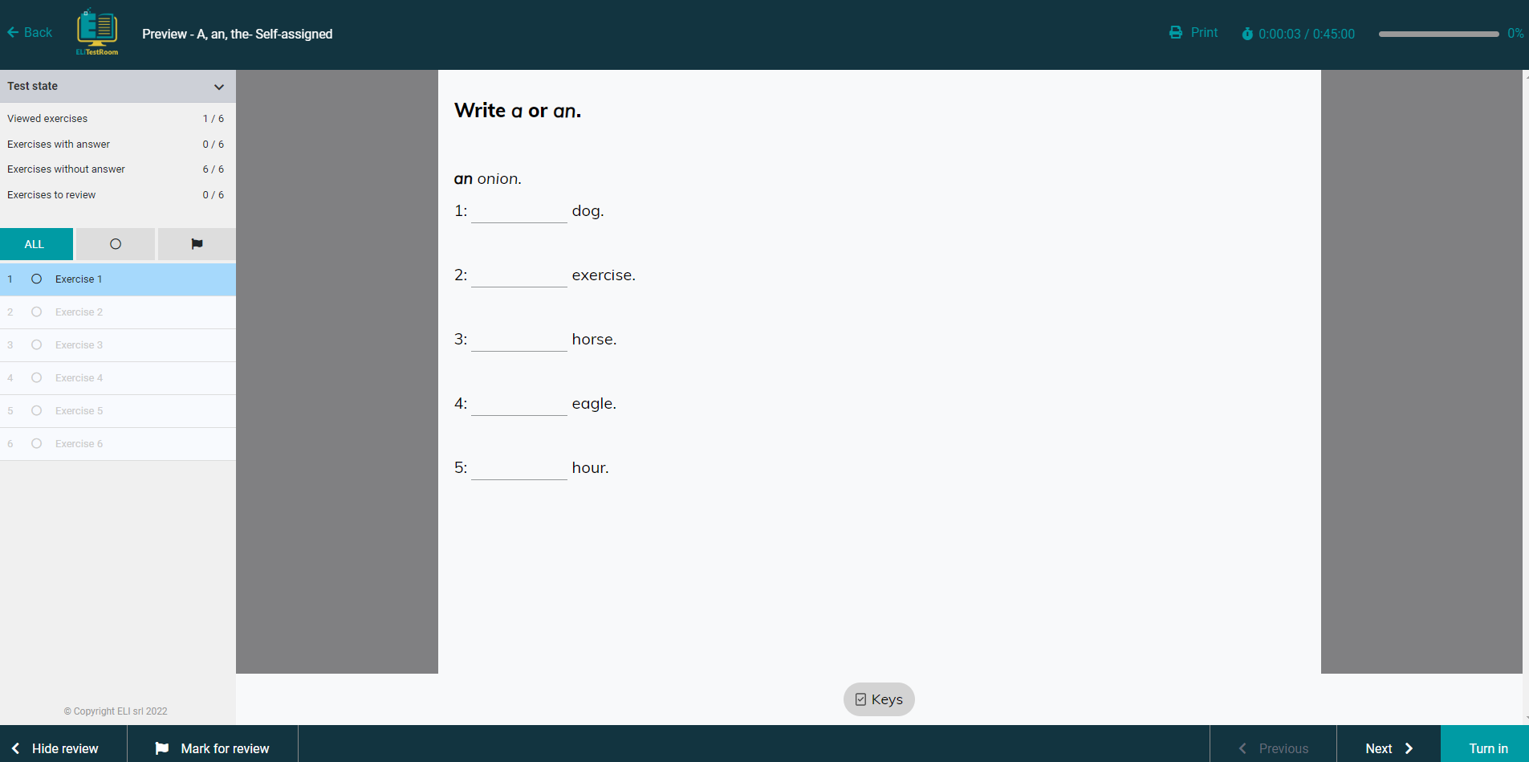
ELi Test Room

Slide 51
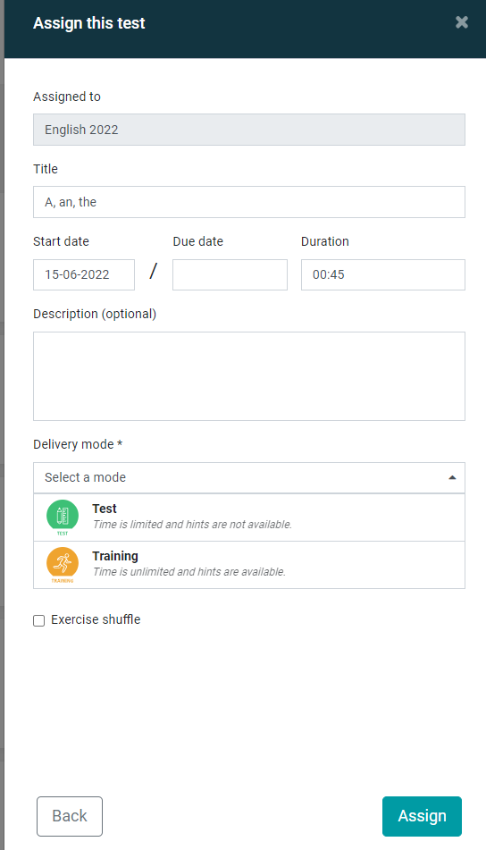
ELi Test Room - How to assign a test
Once a teacher has created a group, they can assign a test and choose the start/due date.
The teacher can select the delivery mode
Test: limited time
Training: unlimited time
Students can do exercises and submit tests only once.

Slide 52
ELi Test Room - Report
Teachers will have access to a complete report with the results of the class and students.
Teachers will also be able to access test and exercise details for each student to evaluate any exercises and review their performance.

Slide 53
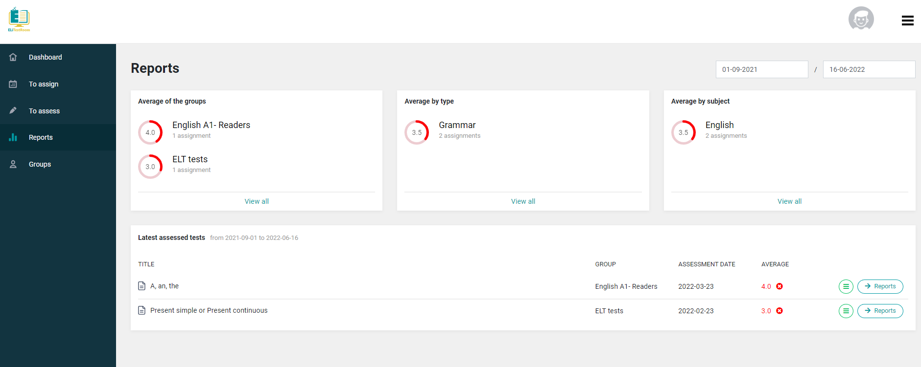

Slide 54
Notes:
dettaglio studente: il docente può vedere il punteggio di ogni singolo esercizio

Slide 55
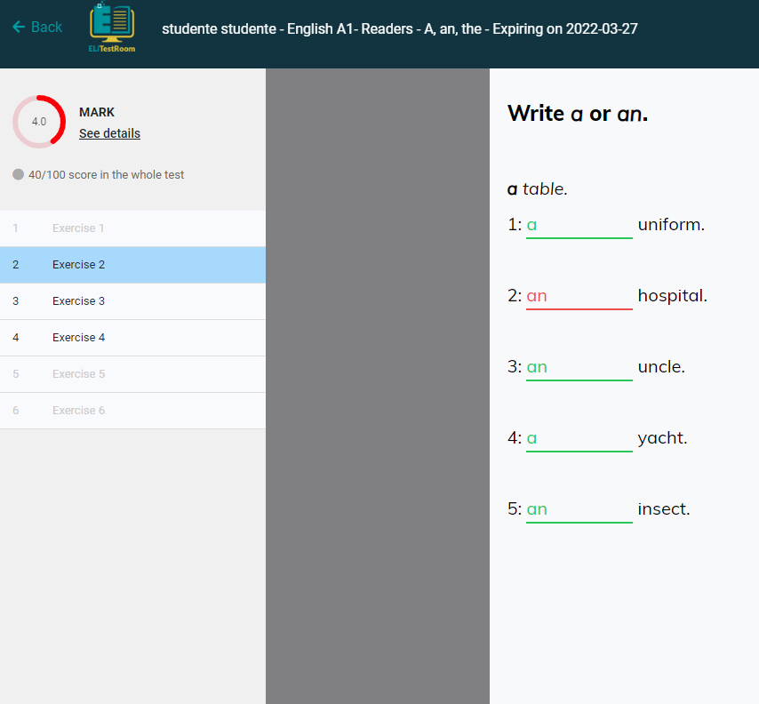
Notes:
dettaglio di un esercizio

Slide 56
ELI LINK

Slide 57
ELI LINK
ELI LINK is the free application that grants your students direct access to all course audio and video resources by scanning their physical textbook with a smartphone or tablet.
Free for Android/iOS
No codes or registration needed
Select your book title and scan the page/cover
Available for all ELi Graded Readers and textbooks on ELi HUB.

Slide 58
How to assign a book to a teacher

Slide 59
How to assign a book to a teacher
A backoffice to assign digital books to teachers
https://backoffice.elionline.com/
Go to https://elidigitalhub.elionline.com/ and create an account. Choose the student profile.
Send an email to support@elidigitalhub.com and request to switch your ELi Digital Hub account to a Promoter account.
In 24/48 hours you will receive the confirmation email

Slide 60
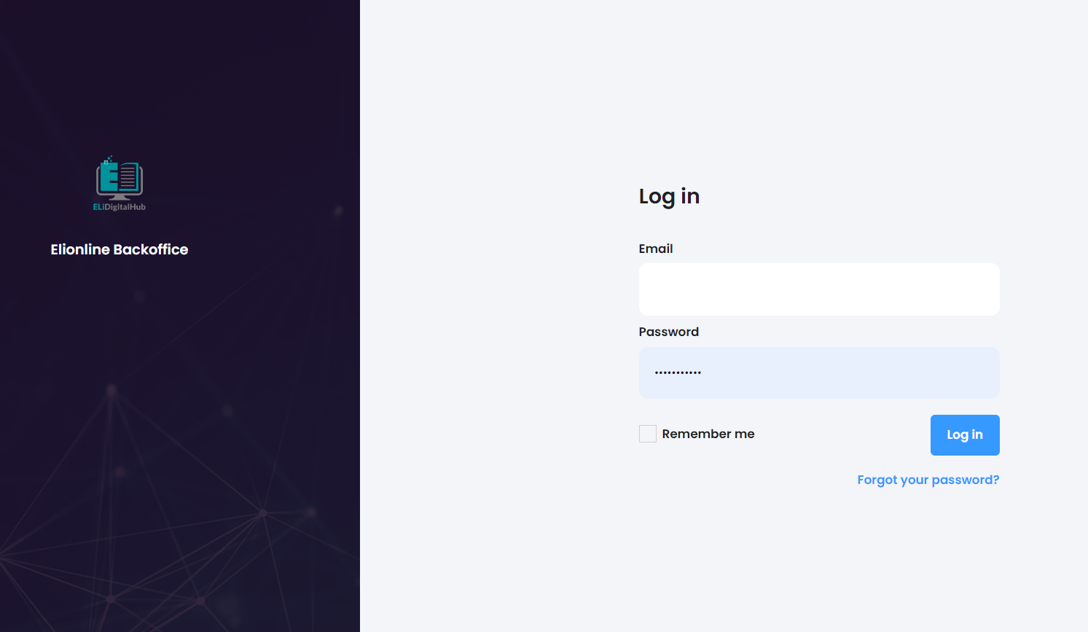

Slide 61
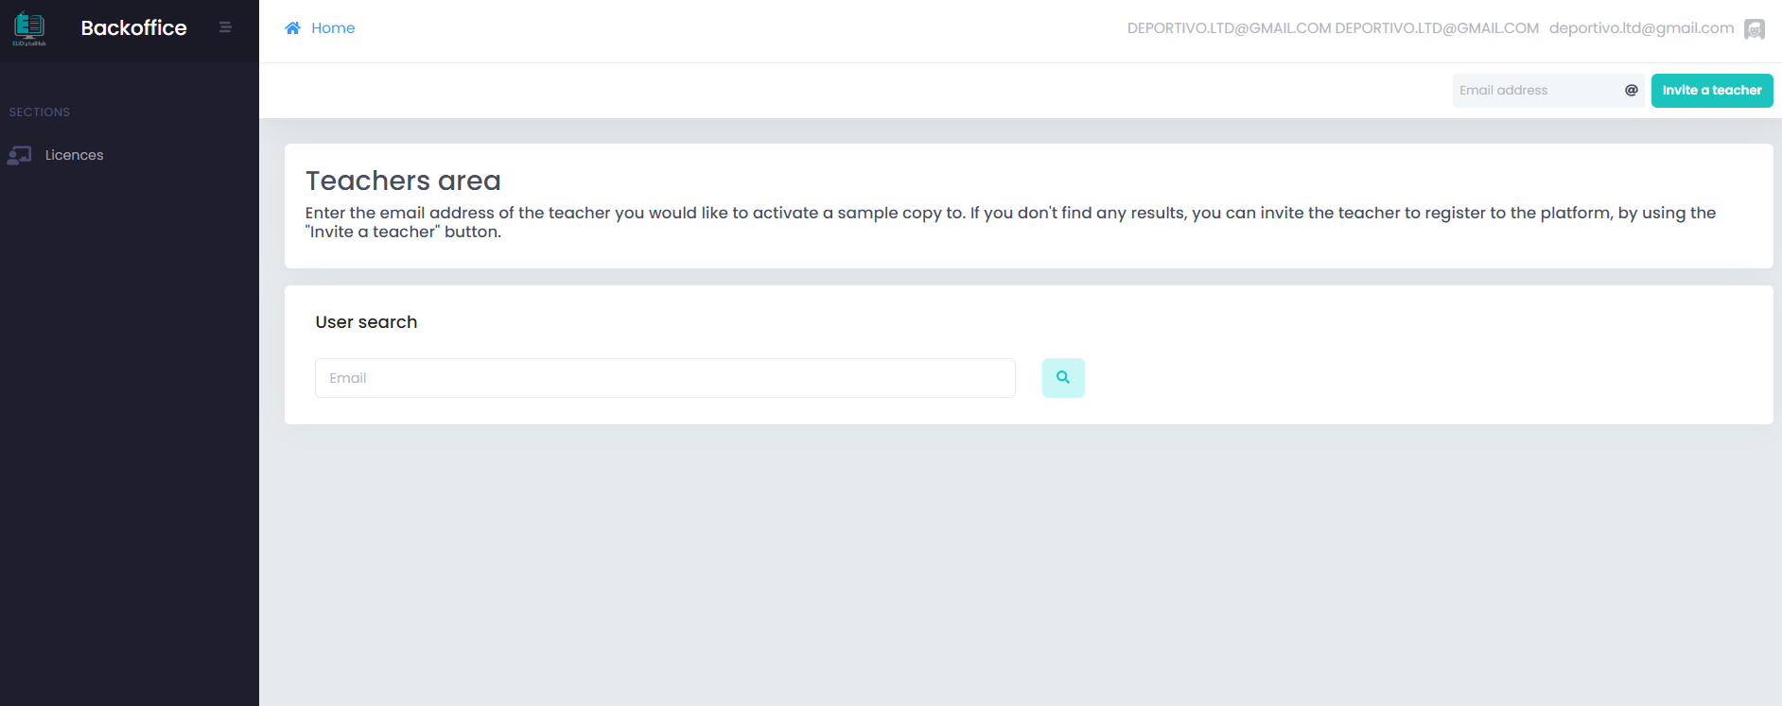
Enter the teacher email

Slide 62
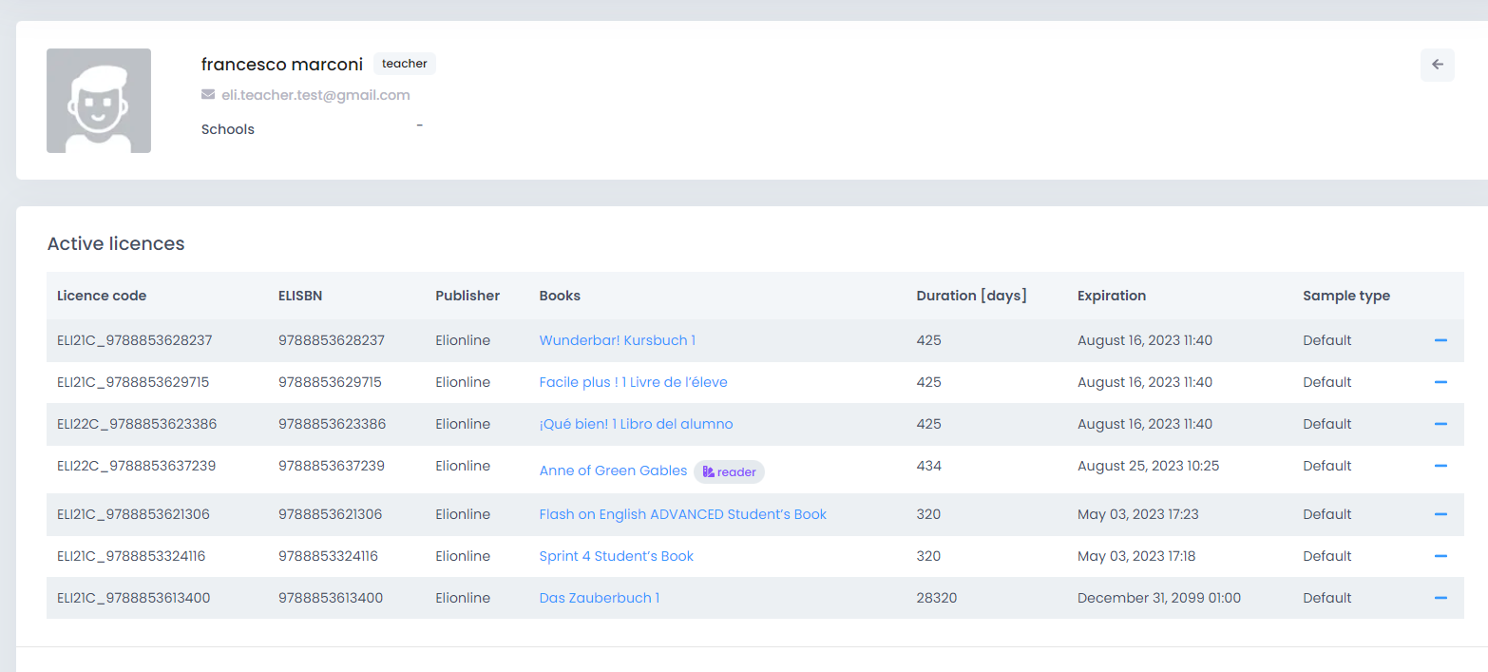
Check the digital books the teacher has activated

Slide 63
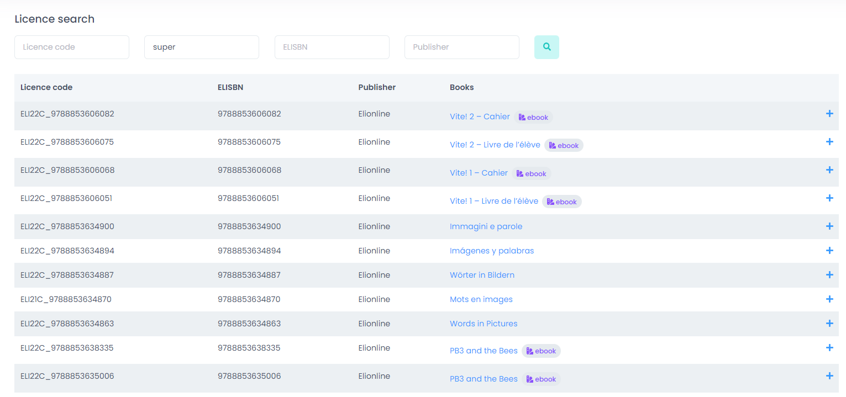
Search for the digital books you want to assign, then clic the icon +

Slide 64
Approved: FULL TIME LIMIT (426 days for the textbooks; 540 days for the readers; no time limit for other products)
Promotional: SET THE TIME LIMIT, Duration or Expiration (maximum 60 days)
TEACHERS WILL RECEIVE A CONFIRMATION EMAIL.

Slide 65
ELi Cloud
cloud.elionline.com

Slide 66
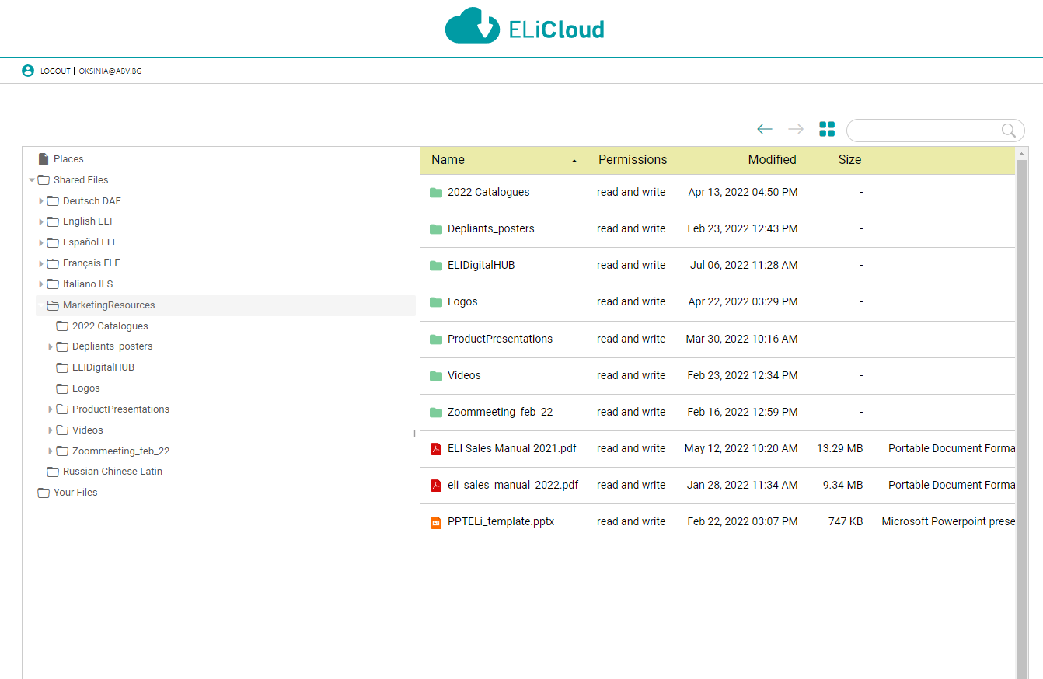
ELi Cloud
A new space where ELi Publishing uploads lots material for the promotion of the volumes.
A folder for each language
A folder for Marketing materials
A personal folder for the distributor
ASK YOUR SALES MANAGER USER AND PWD.

Slide 68
Francesco Marconi
f.marconi@elionline.com
+39 335 6515 534

